Slide 1
CIS8695 Managing Big Data Analytics
Nasim Mousavi
Assistant Professor
J. Mack Robinson College of Business
Georgia State University
nmousavi@gsu.edu

Slide 2
Ensembles

Slide 3
Ensembles
To improve the predictive power of a decision tree, we can construct multiple trees based on subsample of the training data
Predict class label of test records by combining the predictions made by multiple trees (e.g., by taking majority vote)

Slide 4
Ensembles
Using majority vote or weighted majority vote
(weighted according to their accuracy or relevance)

Slide 5
Ensembles
Random Forest (Bagging)
Bagging chooses a random sample/random subset from the entire data set
Boosted Trees (Boosting)
A boosting algorithm combines multiple simple models (also known as weak learners or base estimators) to generate the final output

Slide 6
Random Forest
Draw multiple random samples from data (“bootstrap resampling” or “bagging”)
Fit tree to each resample using a random set of predictors
Combine the classifications/predictions from all the resampled trees (the “forest”) to obtain improved predictions
Basic idea: Taking an average of multiple estimates (models) is more reliable than just using a single estimate

Slide 7
Steps in Random Forest
Step 1: A subset of data points and a subset of features is selected for constructing each decision tree.
Simply put, n random records and m features are taken from the data set having k number of records.
Step 2: Individual decision trees are constructed for each sample.
Step 3: Each decision tree will generate an output.
Step 4: Final output is considered based on Majority Voting or Averaging for Classification and regression, respectively.

Slide 8
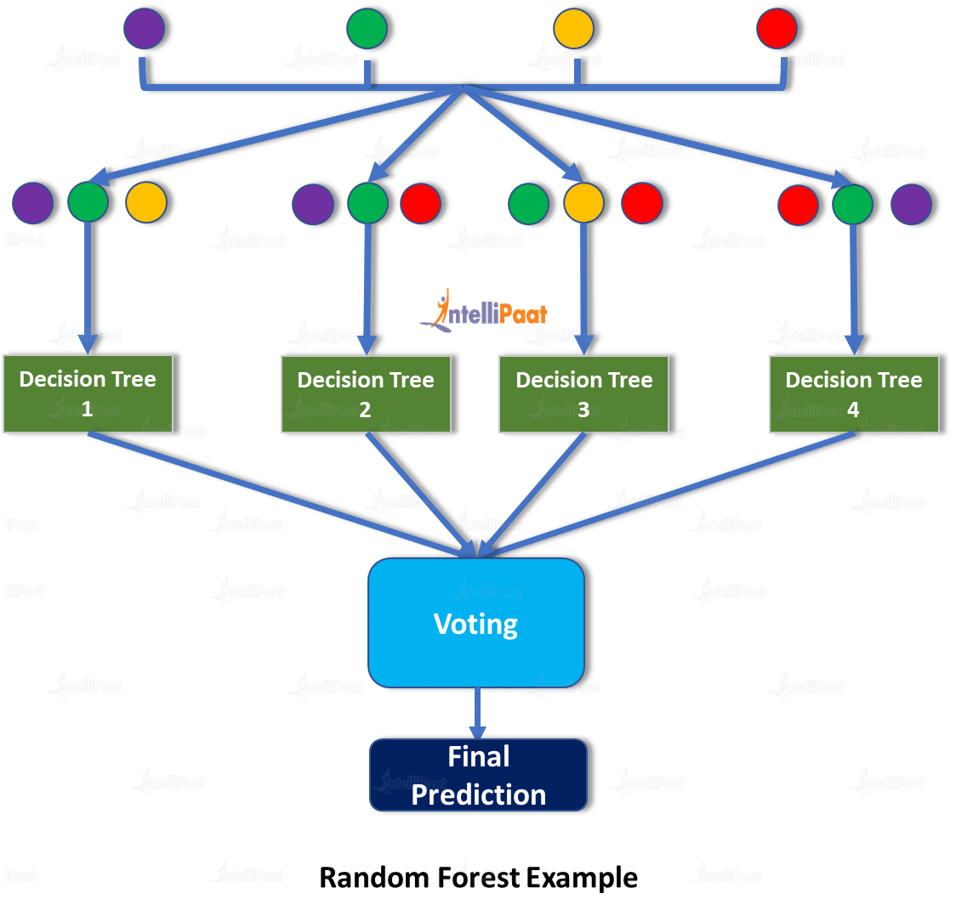
Random Forest

Slide 9
Variable Importance
Each variable is used by some trees and not others
We can, therefore, measure each variable’s contribution to reducing impurity (reduction in Gini Index)
This is the variable importance score

Slide 10
Variable Importance
Output
feature importance std
7 Securities Account 0.003964 0.004998
9 Online 0.006394 0.005350
10 CreditCard 0.007678 0.007053
6 Mortgage 0.034243 0.023469
1 Experience 0.035539 0.016061
0 Age 0.036258 0.015858
8 CD Account 0.057917 0.043185
3 Family 0.111375 0.053146
4 CCAvg 0.172105 0.103011
5 Education 0.200772 0.101002
2 Income 0.333756 0.129227

Slide 11
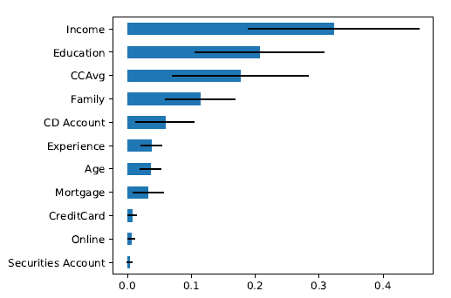
Variable Importance Plot

Slide 12
Features of Random Forest
Diversity: Not all attributes/variables/features are considered while making an individual tree; each tree is different
Immune to the curse of dimensionality: Since each tree does not consider all the features, the feature space is reduced
Train-Test split: In a random forest, we don’t have to segregate the data for train and test as there will always be 30% of the data which is not seen by the decision tree.

Slide 13
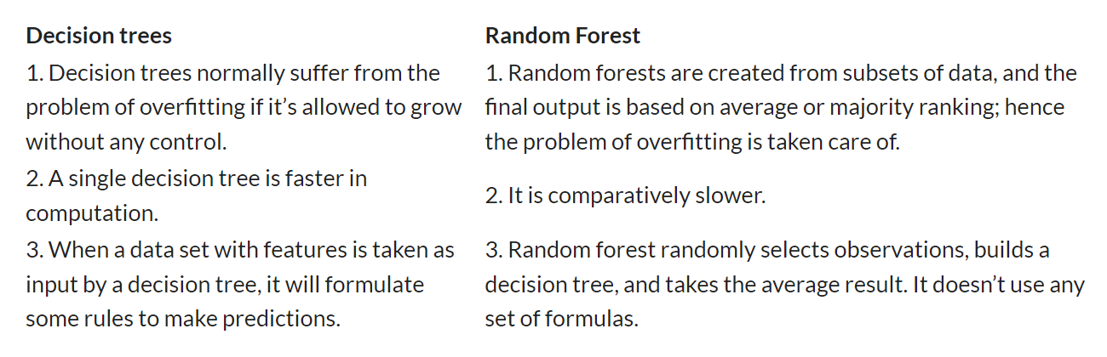
Decision Tree vs. Random Forest

Slide 14
Boosted Trees
Boosting means combining a learning algorithm in series to achieve a strong learner from many sequentially connected weak learners
In case of gradient boosted decision trees algorithm, the weak learners are decision trees

Slide 15
Boosted Trees
Each tree attempts to minimize the errors of previous tree
Trees in boosting are weak learners but adding many trees in series and each focusing on the errors from previous one make boosting a highly efficient and accurate model
The weak learners are fit in such a way that each new learner fits into the residuals of the previous step so as the model improves

Slide 16
Boosted Trees
Fits a succession of single trees
Each successive fit up-weights the misclassified records from prior stage
You now have a set of classifications or predictions, one from each tree
Use weighted voting for classification, weighted average for prediction, higher weights to later trees

Slide 17
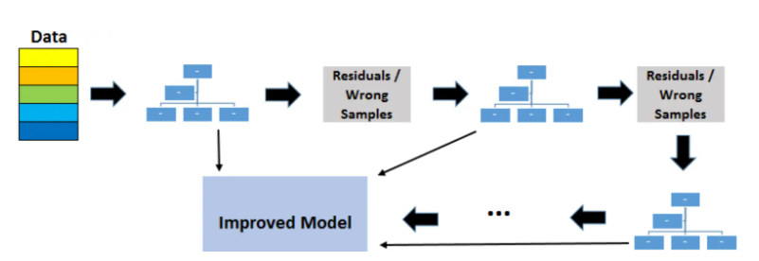
Boosted Trees

Slide 18
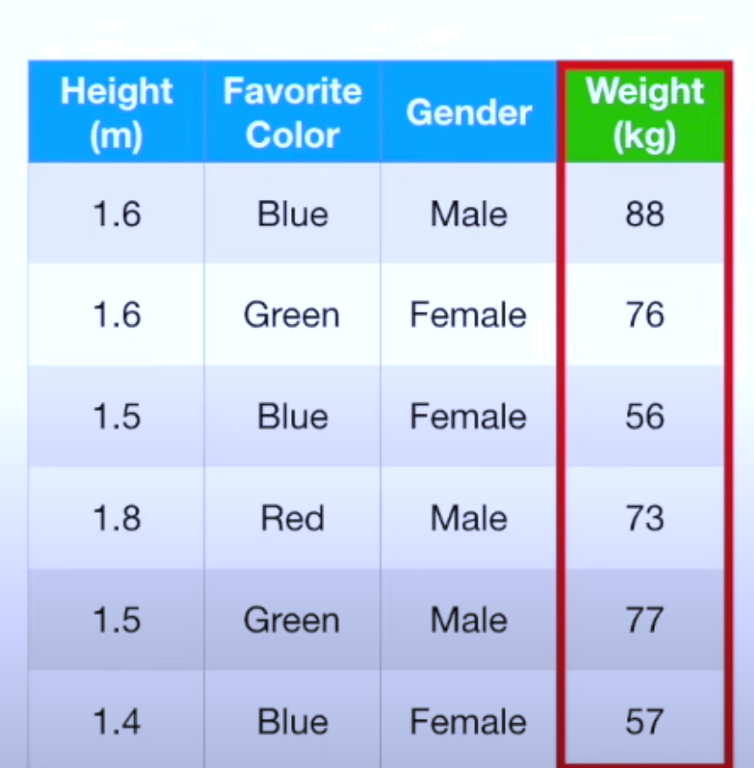
Boosted Trees: Example
Step 1: Use a training data to predict weight

Slide 19
Boosted Trees: Example
A decision tree predicts the average weight is 71.2

Slide 20
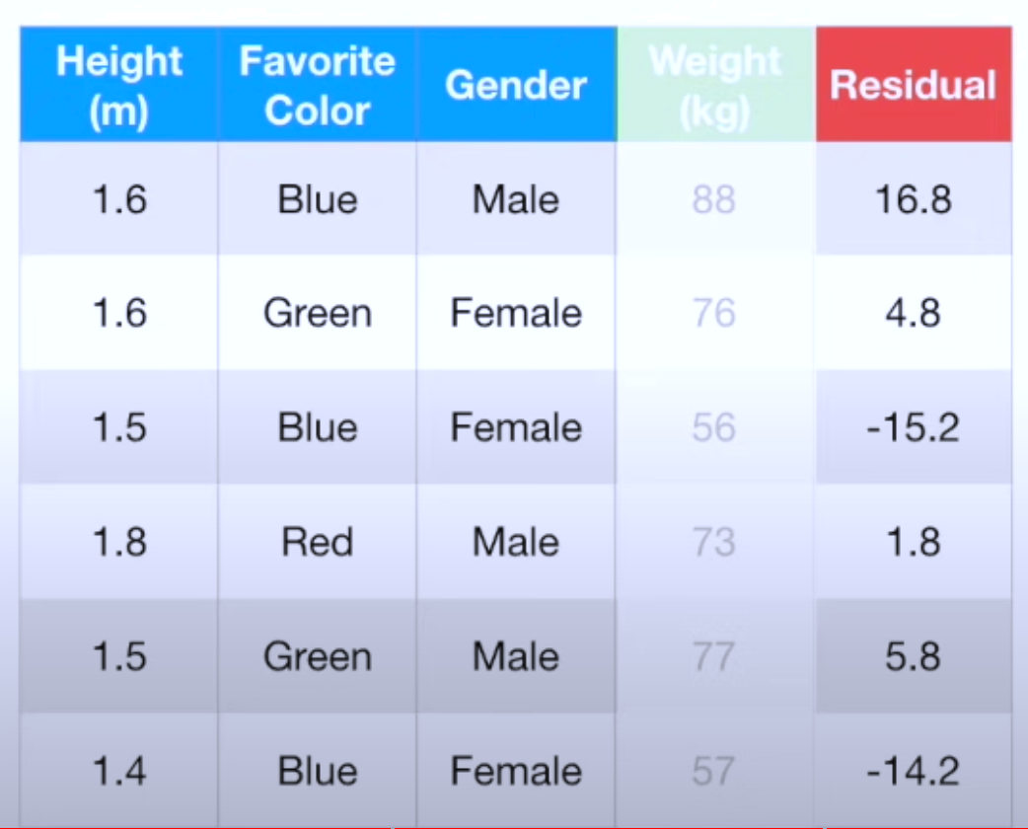
Boosted Trees: Example
The residual for each observation is calculated.

Slide 21
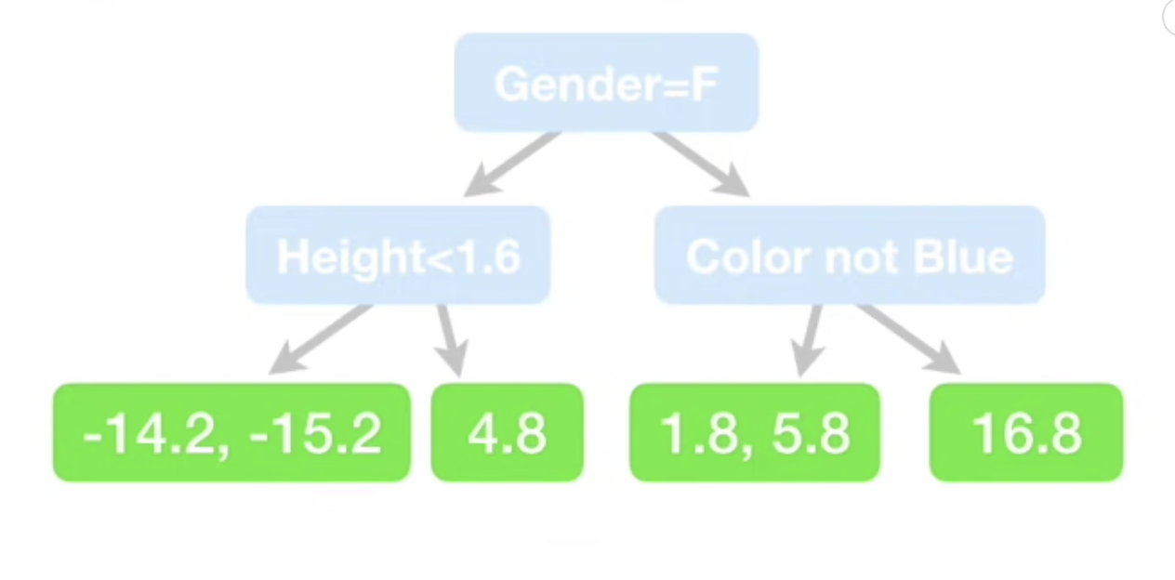
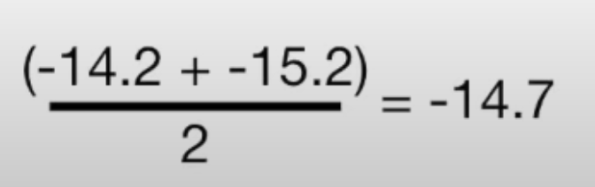
Boosted Trees: Example
Step2: Build a new tree that gets the three predictors to predict residuals
Replace the residuals with their average

Slide 22
Boosted Trees: Example
Our final prediction for each observation would be:
predicted value in Step1 + predicted value in Step2
71.2-14.7=56.5
Almost the same is the original value (56)
Low bias, but probably high variance

Slide 23
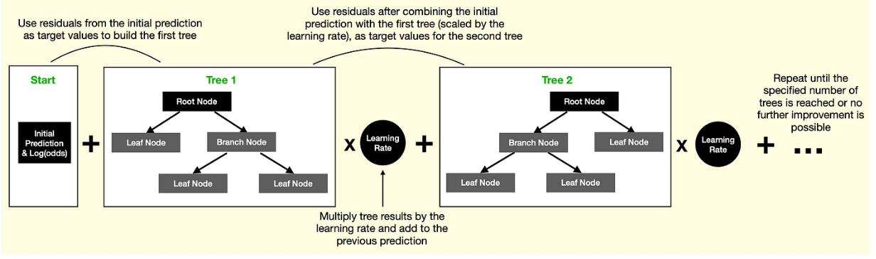
Boosted Trees
Learning rate is used to mitigate this issue to scale the contribution of the new tree.
Learning rate>0 & Learning rate<1

Slide 24
Boosted Trees: Example
If we set learning rate = 0.2
71.2-(0.2*14.7) = 68.26
It is not as good as without the learning rate but it is better than the very original one (71.2)

Slide 25
Boosted Trees: Example
According to the inventor of boosted trees, many small improvement will result a big improvement
Hence, we can have multiple trees with a small learning rate to enhance the final prediction
We can continue this process until we reach a maximum number of specified trees or
Adding a tree does not reduce the size of residuals significantly

